Slide 1

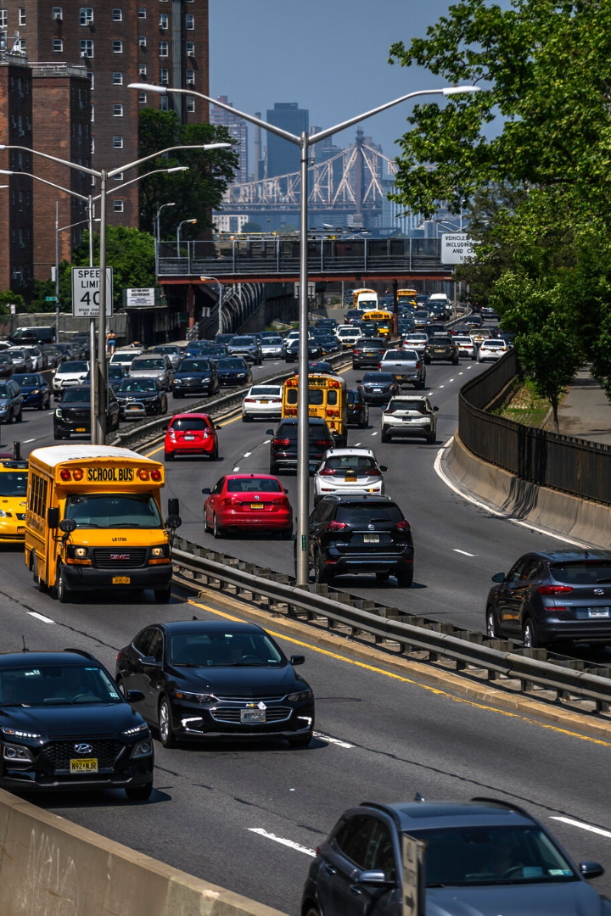


IoT Sensor Design: Plan the deployment of IoT devices (sensors) to monitor traffic flow and congestion.
In this presentation, we will explore the exciting world of IoT sensor design for traffic monitoring. Discover the benefits and challenges of deploying IoT devices to optimize traffic flow.
by Elumalai. V ECE

Slide 2

Introduction to IoT Sensor Design
Learn the basics of IoT sensor design and its key role in gathering data for traffic monitoring. Explore how IoT technologies enable real-time monitoring and analysis.

Slide 3

Overview of Traffic Flow Monitoring
Understand the importance of traffic flow monitoring and its impact on urban planning and transportation systems. Discover how IoT sensors can revolutionize traffic management.

Slide 4
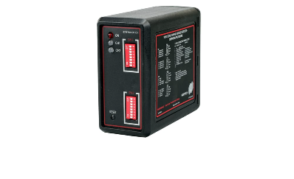
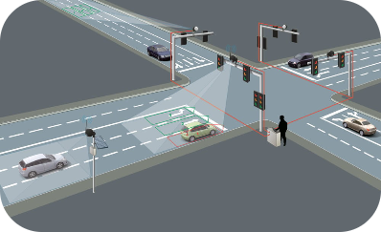
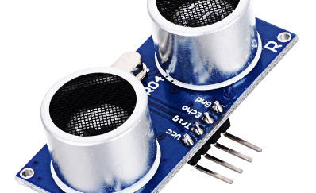
Types of IoT Sensors for Traffic Monitoring
Inductive Loop Sensors
Video-Based Sensors
Ultrasonic Sensors
Explore the functionality and applications of inductive loop sensors, which detect vehicles by measuring changes in magnetic fields.
Discover the capabilities of video-based sensors for traffic monitoring. Learn how these sensors use computer vision algorithms to analyze traffic patterns.
Learn about ultrasonic sensors and their ability to measure traffic congestion by emitting sound waves and analyzing their reflections.

Slide 5
Factors to Consider When Planning Sensor Deployment
Location
Connectivity
Discover how choosing the right locations for sensor deployment can maximize data collection accuracy and coverage.
Explore the importance of reliable connectivity options for IoT sensors to transmit data in real-time for efficient traffic monitoring.
Power Supply
Data Security
Learn about the different power supply options for IoT sensors and their implications for long-term deployment and maintenance.
Understand the criticality of implementing robust data security measures to protect sensitive traffic-related information collected by IoT sensors.

Slide 6
Methods for Data Collection and Analysis
1
Data Collection
Explore various methods of collecting traffic data, including real-time monitoring using IoT sensors and integration with existing transportation infrastructure.
Data Analysis
2
Learn about advanced data analysis techniques for extracting valuable insights from traffic data gathered by IoT sensors, enabling informed decision-making.
3
Visualization
Discover the power of visualizing traffic data through interactive dashboards and maps, facilitating a comprehensive understanding of traffic patterns.

Slide 7
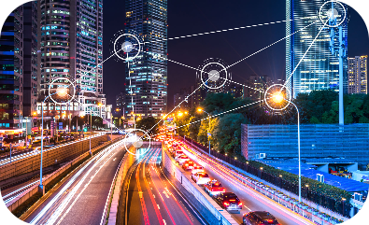
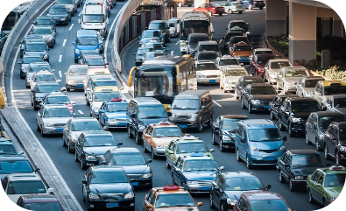

Real-World Applications of IoT Traffic Monitoring
Smart Cities
Traffic Congestion Management
Environmental Impact Reduction
See how IoT traffic monitoring contributes to the development of smart cities, enhancing transportation efficiency and improving quality of life.
Learn how IoT sensor data assists in identifying traffic congestion hotspots and optimizing traffic flow through intelligent traffic management systems.
Discover how using IoT sensors for traffic monitoring can lead to reduced carbon emissions and a greener transportation ecosystem.

Slide 8

Conclusion and Future Directions
Reflect on the potential of IoT sensor technology for revolutionizing traffic monitoring and explore the future possibilities and advancements in the field.

